Slide 1
Chapter 3
Arithmetic for Computers
Notes:
Morgan Kaufmann Publishers
Chapter 3 — Arithmetic for Computers

Slide 2
How To Do Binary Division!
Chapter 3 — Arithmetic for Computers — <number>

Slide 3
Division
§3.4 Division
Check for 0 divisor
Long division approach
  If divisor ≤ dividend bits
    1 bit in quotient, subtract
  Otherwise
    0 bit in quotient, bring down next dividend bit
Restoring division
  Do the subtract, and if remainder goes < 0, add divisor back
Signed division
  Divide using absolute values
  Adjust sign of quotient and remainder as required
quotient
dividend
1001
1000 1001010
-1000
10
101
1010
-1000
10
divisor
remainder
n-bit operands yield n-bit
quotient and remainder
Chapter 3 — Arithmetic for Computers — <number>
Notes:
Morgan Kaufmann Publishers
Chapter 3 — Arithmetic for Computers

Slide 4


Division Hardware
Initially divisor in left half
Initially dividend
Chapter 3 — Arithmetic for Computers — <number>
Notes:
Morgan Kaufmann Publishers
Chapter 3 — Arithmetic for Computers

Slide 5
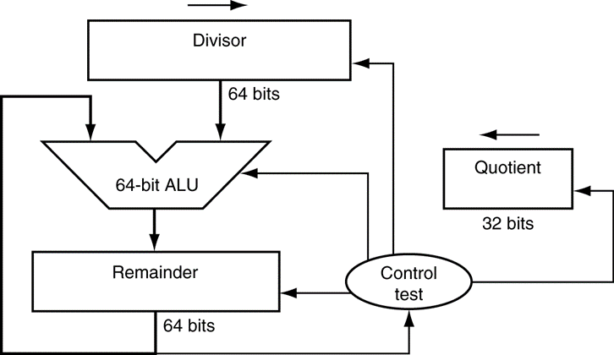
Example
Step | Q | D | R
Initial Vals
0000
0010 0000
0000 0111
R=R-D
0000
0010 0000
1110 0111
Dividend=7 and Divisor=2
Result: Q=3 and R=1
1
R=R+D, SL Q₀=0
0000
0010 0000
0000 0111
SR D
0000
0001 0000
0000 0111
R=R-D
0000
0001 0000
1111 0111
2
R=R+D, SL Q₀=0
0000
0001 0000
0000 0111
SR D
0000
0000 1000
0000 0111
R=R-D
0000
0000 1000
1111 0111
3
R=R+D, SL Q₀=0
0000
0000 1000
0000 0111
SR D
0000
0000 0100
0000 0111
R=R-D
0000
0000 0100
0000 0011
0001 0000
0000 0010
0010 0000
0001
0000 0100
0000 0011
0000 1000
0000 0100
0001 0000
0010 0000
0001 0000
0000 0001
SL Q₀=1
0000 0010
0000 0100
0000 1000
0000 0010
0000 0100
0000 1000
0010 0000
4
SR D
0001
0000 0010
0000 0011
R=R-D
0001
0000 0010
0000 0001
0011
0011
0000
0001
0000
0000
0000
0001
0000
0000
0000
0000
0000
0001
0000
0000
5
SL Q₀=1
0011
0000 0010
0000 0001
SR D
0011
0000 0001
0000 0001
0000 0011
0000 0011
0000 0001
1111 0111
0000 0001
0000 0111
0000 0001
0000 0111
0000 0111
0000 0111
0000 0111
0000 0011
1111 0111
0000 0111
1110 0111
0000 0111
Chapter 3 — Arithmetic for Computers — <number>
Notes:
Morgan Kaufmann Publishers
Chapter 3 — Arithmetic for Computers

Slide 6
Improving Division Hardware
Last step reveals that,
  MS 32bits of Divisor & Remainder is all zeros
So we can combine Quotient and Remainder into one 64 register
  On each step we shift left reminder which is equivalent to shifting left the divisor
  No shifting for the divisor and hence it will be 32 bits
  Since we now will add 32 bits each the adder can be reduced to 32 bits
0000 0001
0011
0000 0001
Chapter 3 — Arithmetic for Computers — <number>

Slide 7

Optimized Divider
One cycle per partial-remainder subtraction
Looks a lot like a multiplier!
  Same hardware can be used for both
Chapter 3 — Arithmetic for Computers — <number>
Notes:
Morgan Kaufmann Publishers
Chapter 3 — Arithmetic for Computers

Slide 8
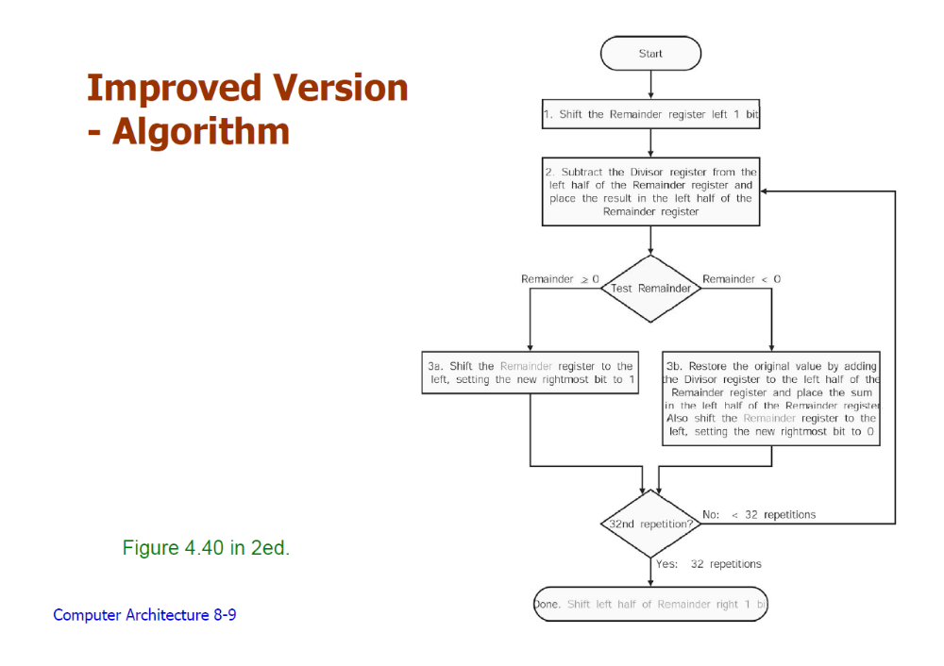
Optimized Divider Algorithm - Example
Divisor | Remainder
0010 | 0000 0111
Chapter 3 — Arithmetic for Computers — <number>

Slide 9
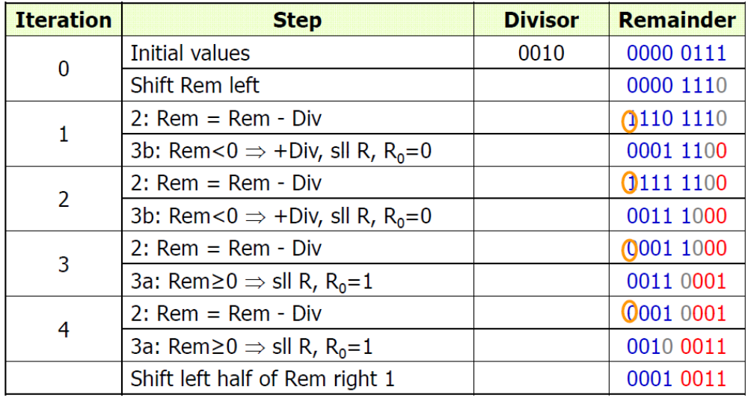
Example: Find 7/2 ?
Chapter 3 — Arithmetic for Computers — <number>

Slide 10
Faster Division
Can’t use parallel hardware as in multiplier
  Subtraction is conditional on sign of remainder
Faster dividers (e.g. SRT devision) generate multiple quotient bits per step
  Still require multiple steps
Chapter 3 — Arithmetic for Computers — <number>
Notes:
Morgan Kaufmann Publishers
Chapter 3 — Arithmetic for Computers

Slide 11
MIPS Division
Use HI/LO registers for result
  HI: 32-bit remainder
  LO: 32-bit quotient
Instructions
  div rs, rt / divu rs, rt
  No overflow or divide-by-0 checking
    Software must perform checks if required
  Use mfhi, mflo to access result
Chapter 3 — Arithmetic for Computers — <number>
Notes:
Morgan Kaufmann Publishers
Chapter 3 — Arithmetic for Computers

Slide 12
Chapter 3 — Arithmetic for Computers — <number>

